Slide 1
A Hand Gesture Recognition System (Live data Tracking)
Presented by Coders Club

Slide 2
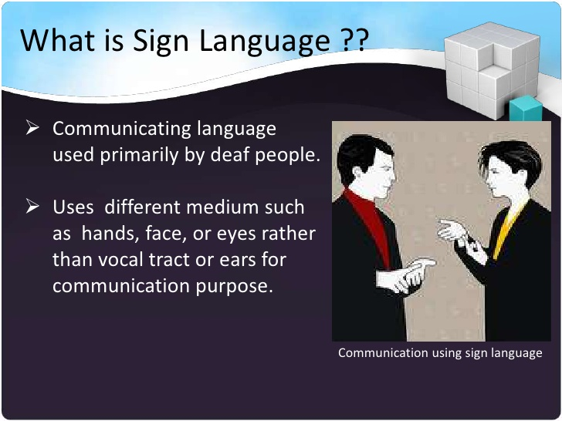

Slide 3
Introduction
Sign Language Recognition (through hand gestures) for deaf and dumb people:
Live data would be captured through webcam and the gestures would be recognized for the people who have a disability in hearing and speaking. Keras-Tensorflow is used for training for the gestures.

Slide 4
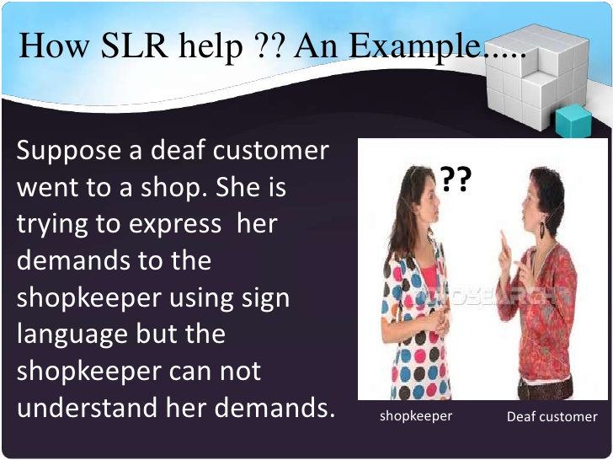
Introduction

Slide 5
Application Areas
It would enable the people with hearing disability to communicate with one another. Gestures would be converted to text and speech, thus enabling interaction with the people.
Also useful for news channels specifically showing programs for deaf and dumb people.

Slide 6
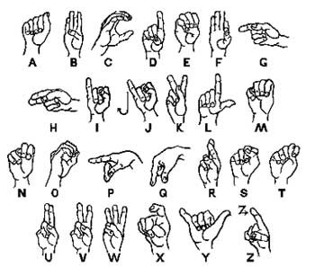

Slide 7
Experiments
52800 images including all 44 hand gestures
For each image:
50*50 image.
Taken from camera with different distance and orientation
Sampled at 15 frames/s

Slide 8
Thank You! Questions?

